Slide 1

KALAIGNARKARUNANIDHI INSTITUTE OF TECHNOLOGY
(An Autonomous Institution by AICTE & Affiliated to Anna University,Chennai)
Coimbatore - 641402
TITLE: HOSPITAL MANAGEMENT SYSTEM USING BLOCKCHAIN TECHNOLOGY
PROJECT GUIDE :
Dr J.SENTHIL KUMAR
TEAM MEMBERS :
J.ASWITHA JEEVARATHINAM – 711522BCS011
P.MAGLIN JENEBELLAH – 711522BCS027
P.HARI NISANTH – 711522BCS019

Slide 2
INTRODUCTION
In the modern healthcare environment, managing hospital systems efficiently is crucial for delivering quality patient care. Traditional systems often struggle with issues like data fragmentation and security vulnerabilities. Blockchain technology offers a promising solution by providing a decentralized, secure, and transparent ledger for managing sensitive information.
By incorporating blockchain into hospital management systems, institutions can enhance data security, ensure accurate patient records, and improve operational efficiency. Blockchain’s features enable real-time updates, secure data sharing, and streamlined administrative processes, addressing many of the challenges faced by traditional systems.

Slide 3
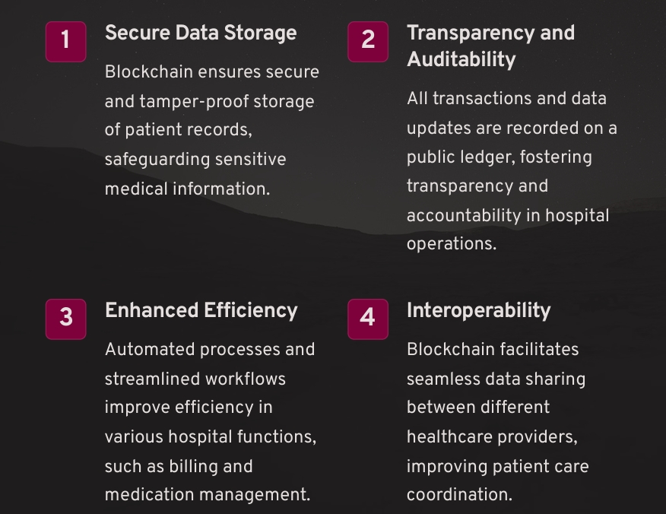
ABSTRACT

Slide 4
OBJECTIVE
Secure Patient Record Management - Implement a secure and decentralized system for storing and managing patient records, ensuring data integrity and privacy.
Transparent Medical Data Sharing - Enable secure and transparent sharing of medical data between authorized healthcare providers, improving patient care coordination.
Efficient Administrative Processes - Streamline administrative tasks such as appointment scheduling, billing, and inventory management through automated processes.
Improved Patient Engagement - Provide patients with secure access to their medical records and facilitate their engagement in their own healthcare decisions

Slide 5
LITERATURE SURVEY
Title: Blockchain-Based Medical Records Secure Storage and Medical Service Framework
Author: Chen, Y.; Ding, S.; Xu, Z.; Zheng, H.; Yang, S.
Title: Blockchain: Solving the privacy and research availability tradeoff for EHR data: A new disruptive technology in health data management
Author: G.Magyar
Title: The biggest medical data breaches in history
Author: Aimee O’Driscoll

Slide 6
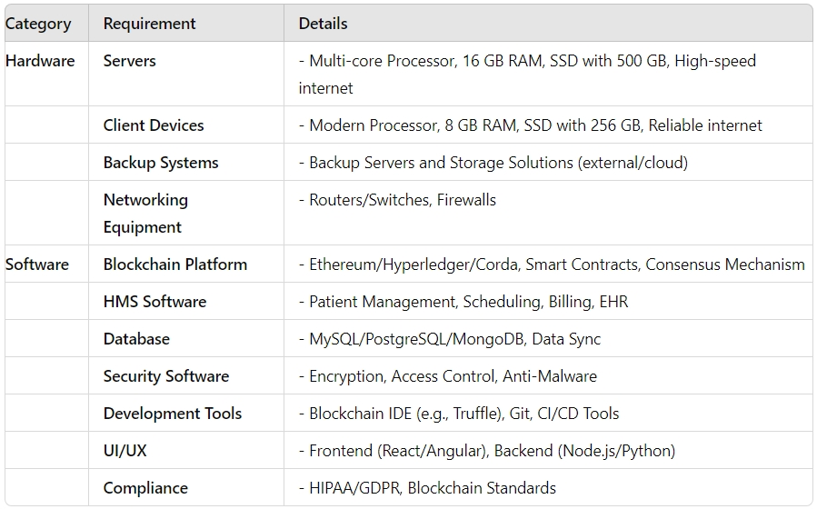
SOFTWARE AND HARDWARE REQUIREMENTS

Slide 7
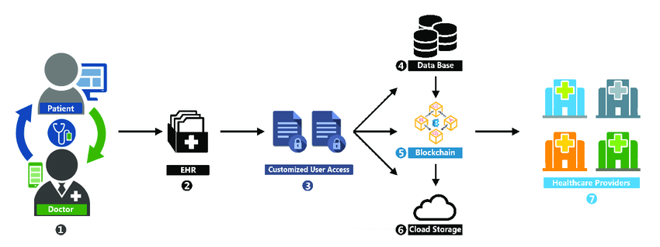
Data flow diagram

Slide 8
Data flow overview
Patient Consultation:
The process starts with the patient visiting the doctor for a consultation.
Data Entry:
The doctor records the patient’s health information into the Electronic Health Records(HER).
Access Control:
Customized user access is set up to e

Slide 9
MODULES
Patient Data Management
Electronic Health Records (EHR)
Supply Chain Management
Appointment Scheduling
Billing and Payments
Prescription Management
Research and Data Sharing
Compliance and Reporting

Slide 10
MODULES DESCRIPTION
Patient Data Management
Secures and manages patient records on a decentralized ledger.
Electronic Health Records (EHR)
Facilitates secure and interoperable sharing of health records.
Supply Chain Management
Tracks and verifies the journey of medical supplies for authenticity.
Appointment Scheduling
Manages appointments with a secure, error-free system.
Billing and Payments
Handles billing and transactions with transparency and security.
Prescription Management
Manages and verifies prescriptions to ensure accuracy and prevent fraud.
Research and Data Sharing
Provides secure and anonymized sharing of research data.
Compliance and Reporting
Ensures regulatory compliance and generates accurate, transparent reports.

Slide 11
CONCLUSION
Enhanced Security: Blockchain provides tamper-proof, encrypted data storage.
Improved Efficiency: Streamlined processes and automated transactions reduce
manual work.
Increased Transparency: Immutable records ensure clear and accountable data
handling.
Better Compliance: Simplified adherence to regulations with accurate, automated
reporting.
Data Integrity: Ensures accurate and reliable information across all modules.
Fraud Prevention: Reduces risk of fraud with verifiable and transparent data.

Slide 12
REFERENCE
"Blockchain Technology in Healthcare: A Comprehensive Review and Directions for Future Research" Authors: A. M. O’Donovan, A. T. Shah, et al. Journal: IEEE Access Link: IEEE Access Article
The Role of Blockchain Technology in Healthcare: A Systematic Review" Authors: A. Y. Sharma, et al. Journal: Health Informatics Journal Link: SAGE Journals Article
Blockchain Technology for Healthcare: A Scoping Review" Authors: S. A. Al-Haddad, et al. Journal: Journal of Medical Internet Research Link: JMIR Article

